Slide 1

A PRESENTATION ON “ONLINE CAR RENTAL SYSTEM ”
GUIDED BY:
PRIYABRATA NAYAK
Asst.Prof. Dept of Software Development
PRESENTED BY:
Sahil Kumar Dhala (1901298183)
Bharadwaj Nayak (1901298095)
Satya Sundar Moharana (1901298192)

Slide 2
Content
Introduction
Literature Review
Objective of the project
Software Requirement
Model Description
ER-Model
Conclusion
Reference

Slide 3
Introduction
An online car rental system is web based on application .
It’s allows a person to book/reserve a vehicle with payment on one end while the company staff handles the transactions, on the other via the Internet.
Online Car Rental Systems are used mostly in developed countries such as England and Australia where electronic commerce has been fully accepted in the society.
Famous companies such as Europcar from United Kingdom, has gained popularity since the business used the technologies available to expand and provide more facilities to their customers.

Slide 4
Literature Review
Reference | Objective | Methology | Conclusion
[1] | The aim of this model evaluation through the bootstrapping menu also generates T-statistics values that will be used to test the hypothesis. The indicator can be used to confirm that the indicator can together with other indicators explain a latent variable | WEB BASED, Structural Equation Modeling (SEM) with SMART PLS software. | The results show the level of community knowledge of smartphone features obtained through Asking more effectively to know the features of a smartphone than with a self-learning approach
[2] | The aim of this research is solving the problems that occur in Avis Indonesia; propose development of web-based car rental management information system. | SDLC,WEB BASED,XAMPP | With web-based car rental management information system, could improve the time efficiency of rental history data transmission after using this application.

Slide 5
Reference | Objective | Methology | Conclusion
[3] | The main purpose of developing SMS-based content alert for car rental system is to reduce the cost and time consumed, which is beneficial to the car rental agencies and customers. Therefore, the system was designed automatically to send an alert SMS to the customers about the availability of the car reserved. | Web-based system, SMS technology, SDLC | The integration of web-based and SMS technology in the car rental agencies is the best way to take the advantages of today technology, in order to enhance the productivity and efficiency of organization.
[4] | Car Rental as a Form of Tourism, And the variety of sizes of their vehicles, car rental agencies may also renting vans or trucks, and in certain markets other types of vehicles such as motorcycles or scooters may also be offered. | Google Analytics Tracking Code (GATC), Google Analytics (GA) | The Google Analytics is a very important tool for assessing a large amount of information about people interested in a specific service. Goals are useful because they enable both the measure of a site’s success and failure when people start a funnel and don’t complete it. But they also enable the segmentation of success and in Google Analytics

Slide 6
Reference | Objective | Methology | Conclusion
[5] | The proposed system aims to build a database of a web-based electronic car rental system that serves customers and car rental companies, so that the customer can open an account as well as rent the car and pay. Enable car rental companies as well as manage the rental operations of the cars available to them, also enable car rental companies' ability to track cars rented from customers based on GPS. | Web Design Process in Agile Methodologies, GPS, web based | Order to enhance the follow and tracking car after rent by customers. In reality, GPS add value to car rental web-based system by add follow and track the car at any time and any location.
[6] | To produce a web-based system that allow customer to register and reserve car online and for the company to effectively manage their car rental business. | Web based, GPS | where every activity of car rental business is limited to a physical location only. Even though the physical location has not been totally eradicated; the nature of functions and how these functions are achieved has been reshaped by the power of internet.

Slide 7
Objective of project
The main objective of the Car Rental System is to manage the details of Car, Payment, Customer.
Convenience: You can get to your destination way easier and quicker than when you use public transportation.
Flexibility: Just drive your car whenever you need and go wherever want. You don’t need to wait for the exact buses and adapt the schedules. Moreover, the GPS technology will make your journey even better - it will be your best guide in route.
Additional services: Most of the rental companies provide additional services making your experience even better and more comfortable. (such as extra equipment, door to door delivery, transfers, group tours etc.)

Slide 8
Software requirement
User Interface Design : HTML 5, CSS 3
Software : XAMPP server
Language Used : PHP
Database : MY SQL
Web Browser : Google Chrome, Mozilla

Slide 9
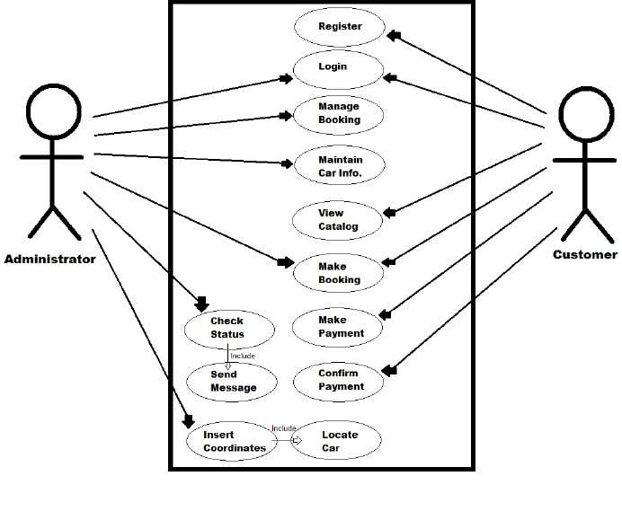
Model Description

Slide 10
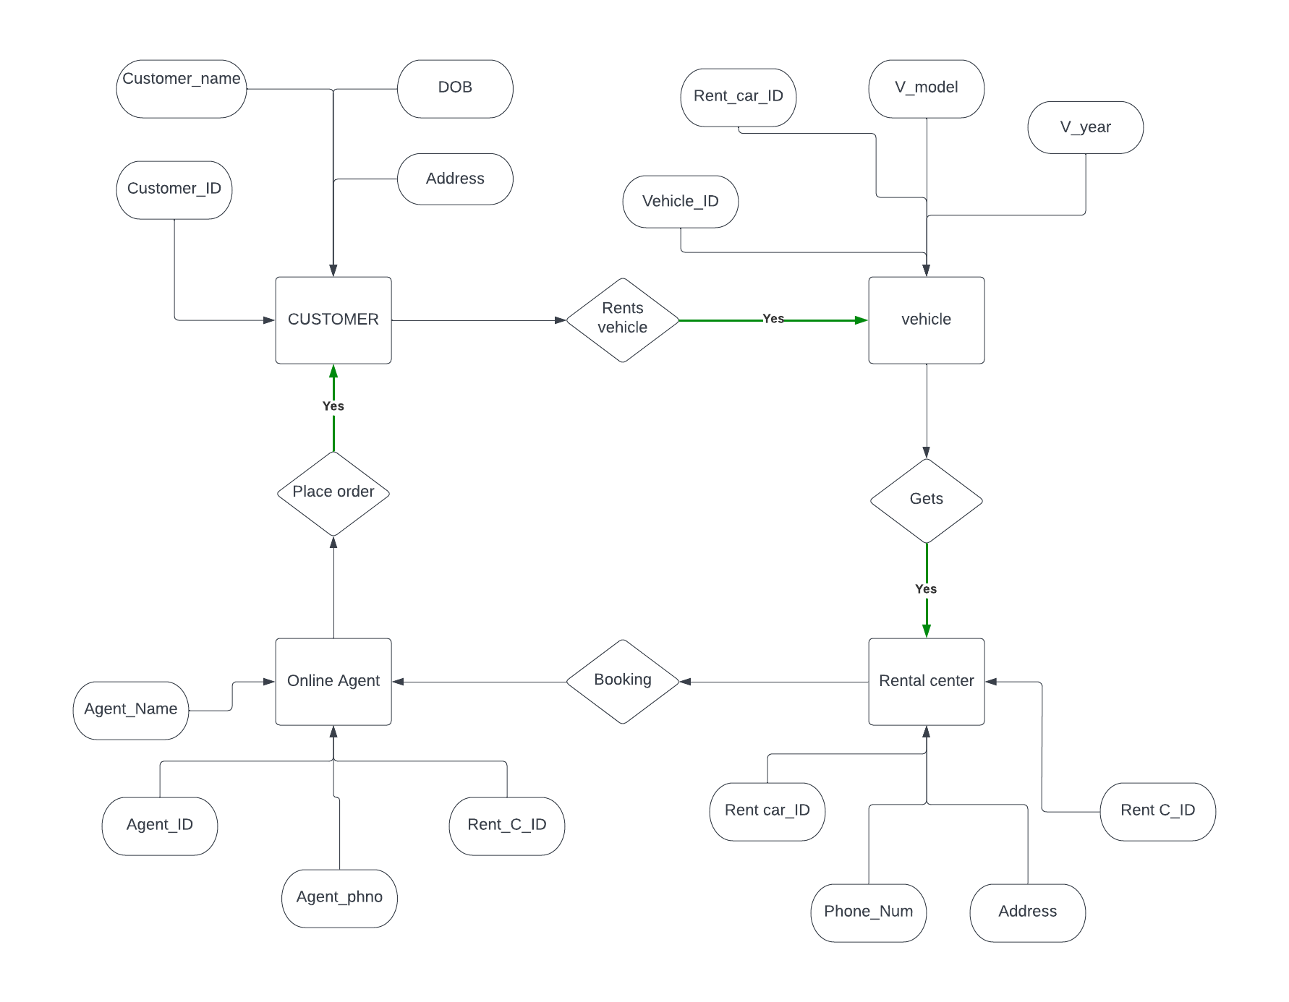
ER-model:-

Slide 11
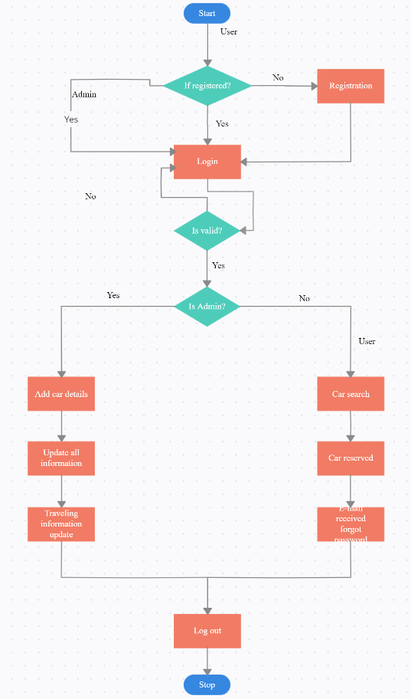
Flow Chart Diagram:-

Slide 12
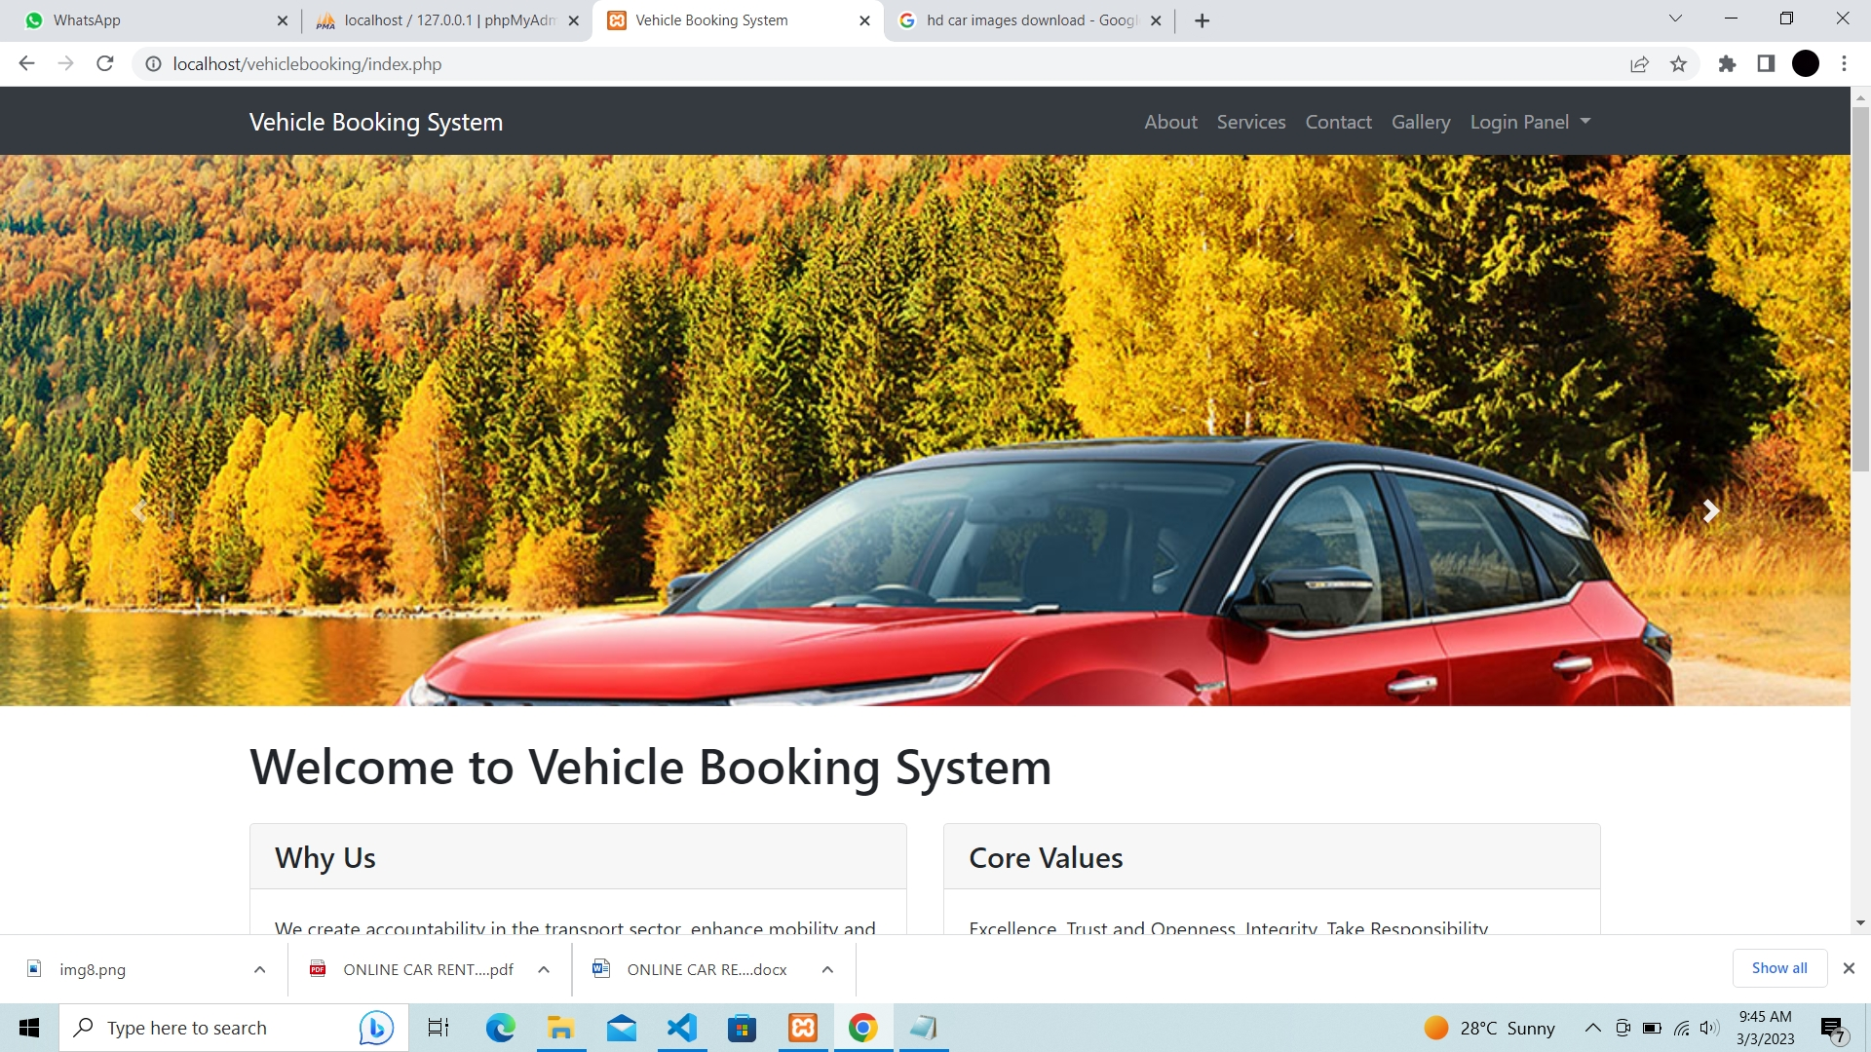
USER INTERFACE

Slide 13
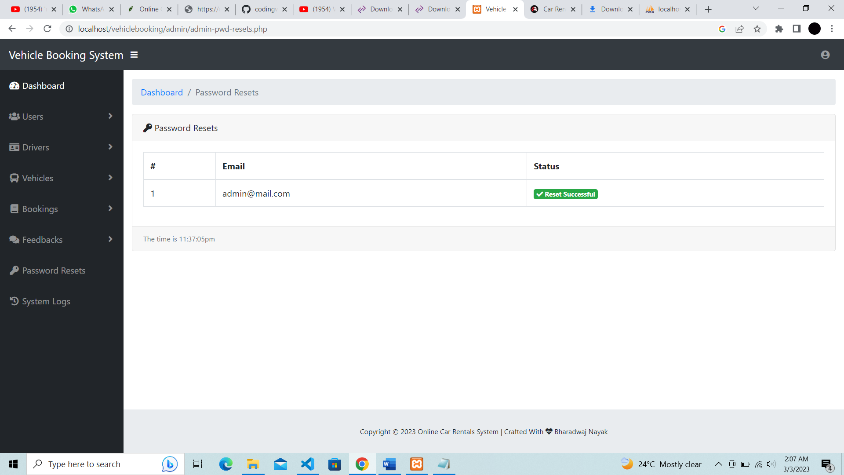

Slide 14
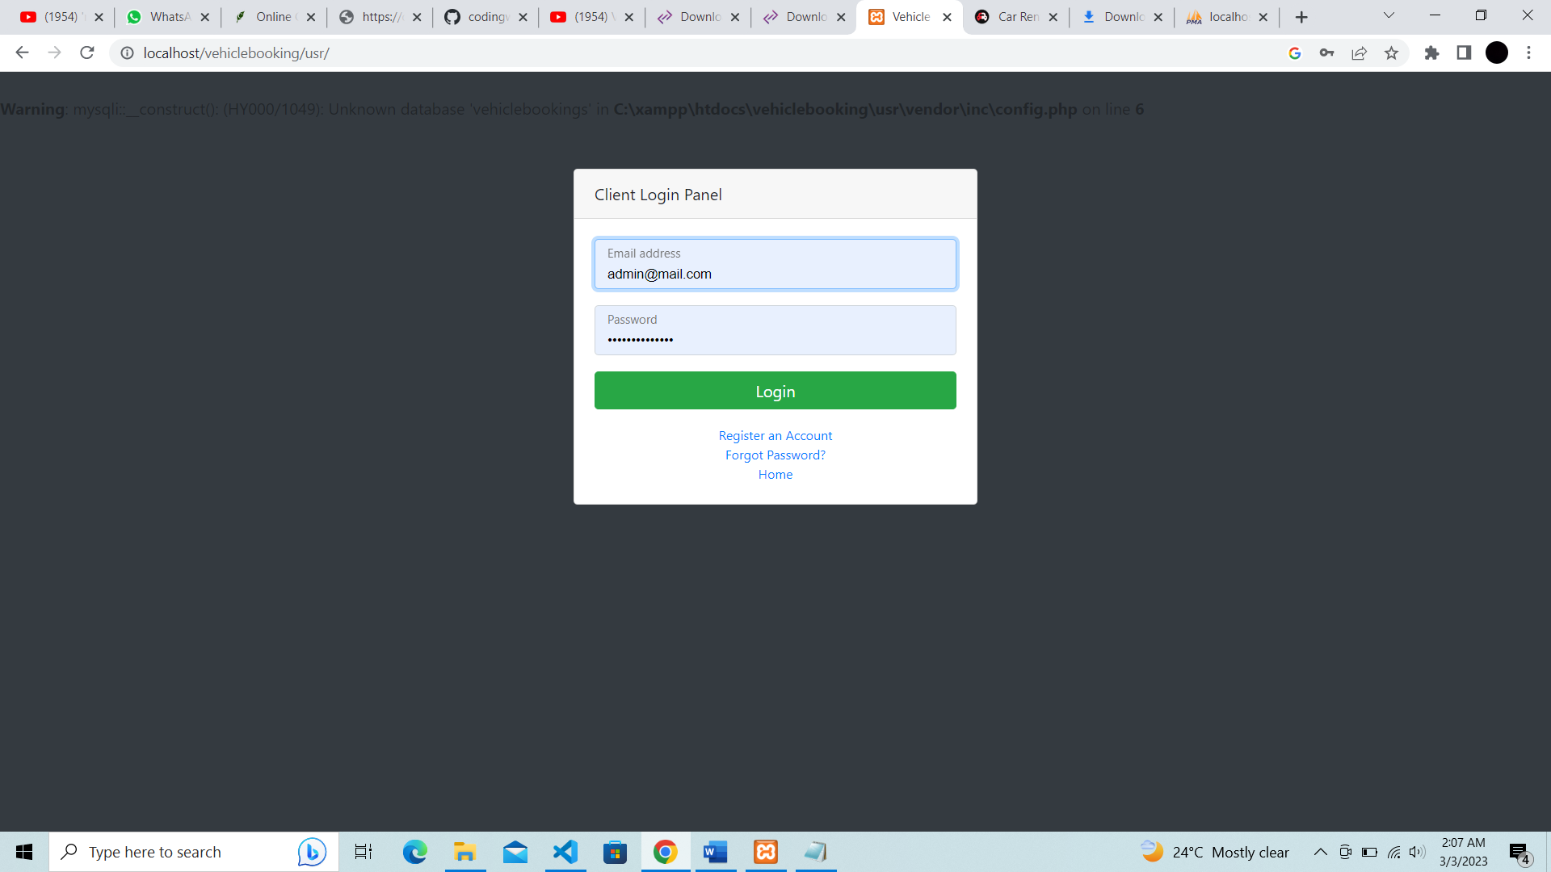

Slide 15
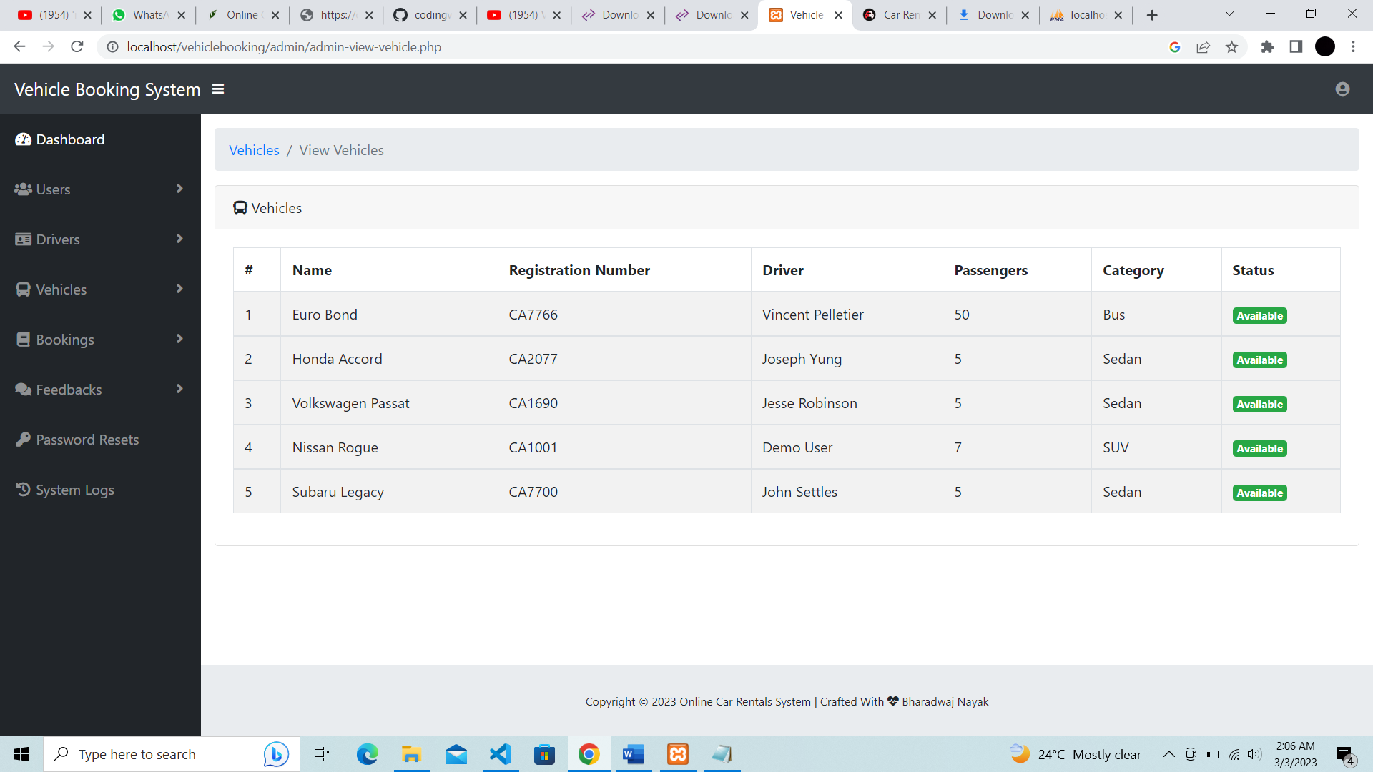

Slide 16
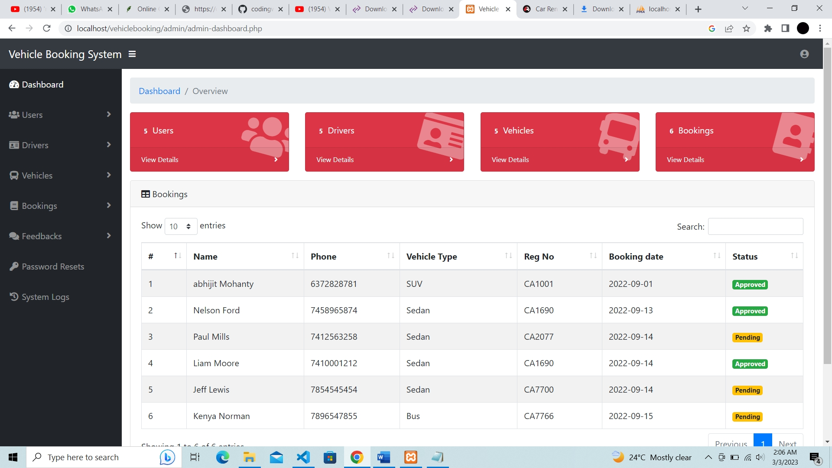

Slide 17
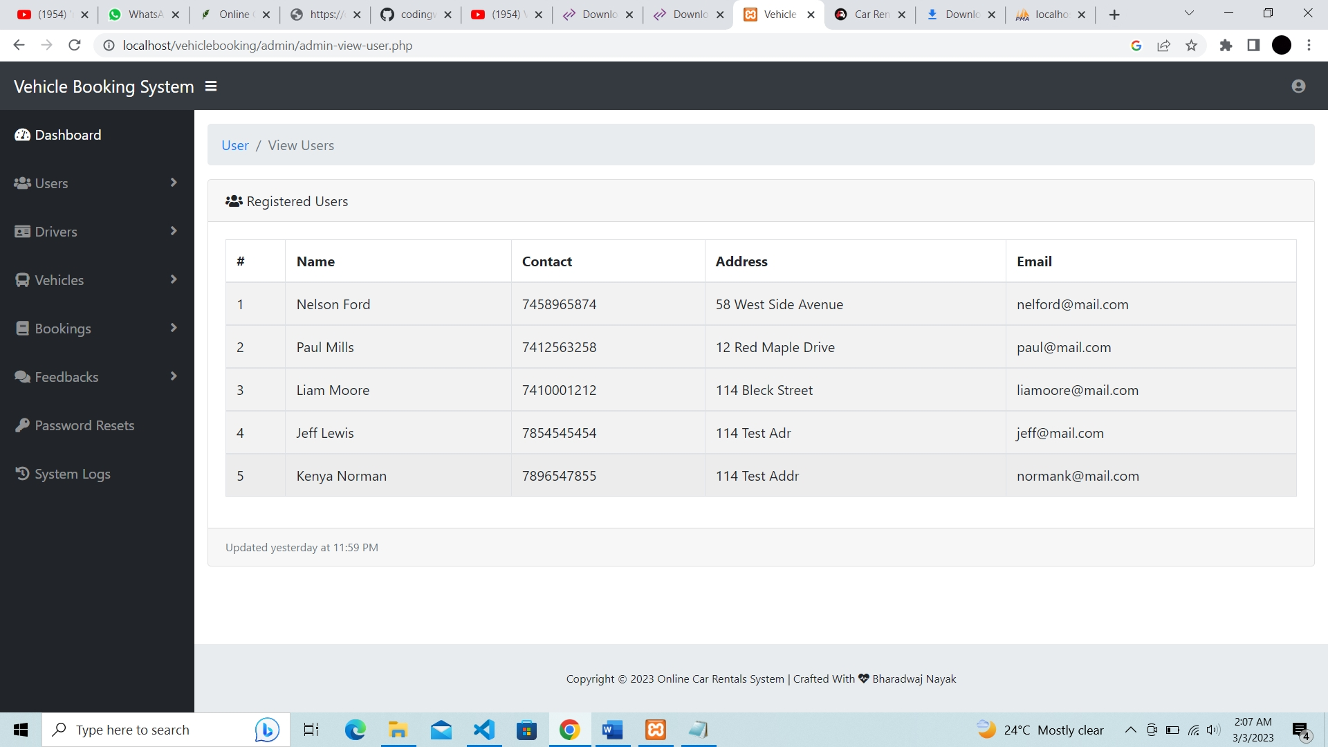

Slide 18
Conclusion
The website will store any information the user may input when making a rental purchase request.
This will appear in real time onto the software used by the employees.
This software provides an easy-to-use interface to allow for simple access to rental requests and customer information..
The website is designed to stay up to date by giving administrators the ability to change/add/remove any featured vehicles on the site.

Slide 19
Reference
Marhayanie, M., Ismail, M., & Muda, I. (2018, January). Impact of Smartphone Features on" Omset" Services Online Car Rental. In 1st Economics and Business International Conference 2017 (EBIC 2017) (pp. 278-281). Atlantis Press.
Waspodo, B., Aini, Q., & Nur, S. (2011). Development of car rental management information system. In Proceedings of The 1st International Conference on Information Systems For Business Competitiveness (ICISBC) (pp. 101-105)..
Osman, M. N., Zain, N. M., Paidi, Z., Sedek, K. A., NajmuddinYusoff, M., & Maghribi, M. (2017). Online car rental system using Web-Based and SMS technology. Computing Research & Innovation (CRINN), 2, 277.
Danila, D. M., & Gaceu, L. (2010). Online Evaluation Method for Assessing the Variation of the Number of Tourists Interested In Car Rental. Bulletin of the Transilvania University of Brasov. Series II: Forestry• Wood Industry• Agricultural Food Engineering, 75-78.
Nasr, O. A., Miladi, M. N., & Ahmed, M. (2020). CAR RENTAL AND TRACKING WEB-BASED SYSTEM USING GPS. IJISCS (International Journal of Information System and Computer Science), 4(2), 63-70.

Slide 20


